Slide 1
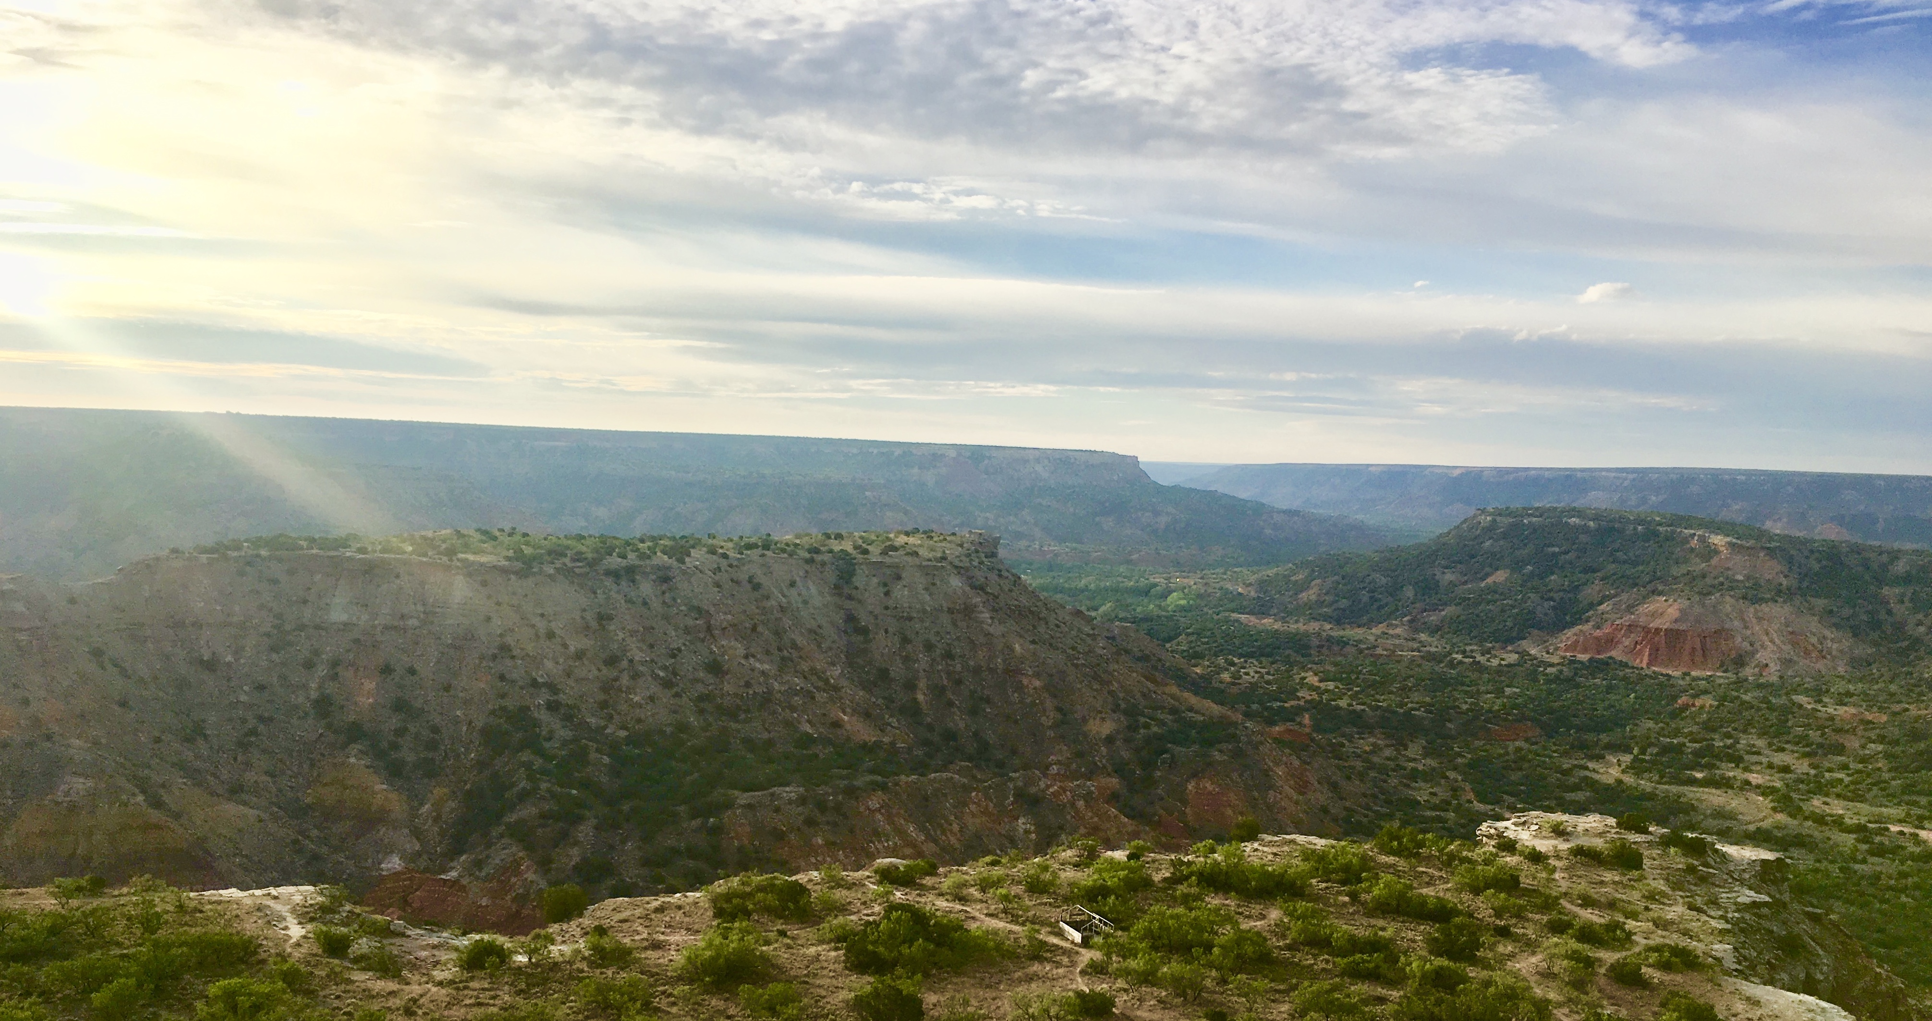
Drivers of plant nutrient acquisition and allocation strategies and their influence on plant responses to environmental change
Evan A. Perkowski
Dissertation Defense
March 07, 2023, 1pm CT ESB1 Room 120
Zoom link:
https://texastech.zoom.us/j/93966902565?pwd=YVZEc0F6dytNY3B1SlNjM1lDVW1VUT09

Slide 2
General Introduction

Slide 3
Adapted from Fig 5.12 in IPCC (2021)

Slide 4
Photosynthesis = largest carbon flux between the atmosphere and land surface
Adapted from Fig 5.12 in IPCC (2021)

Slide 5
Photosynthesis = largest carbon flux between the atmosphere and land surface
Terrestrial biosphere models must accurately simulate photosynthetic processes to predict ecosystem responses to environmental change
Adapted from Fig 5.12 in IPCC (2021)

Slide 6
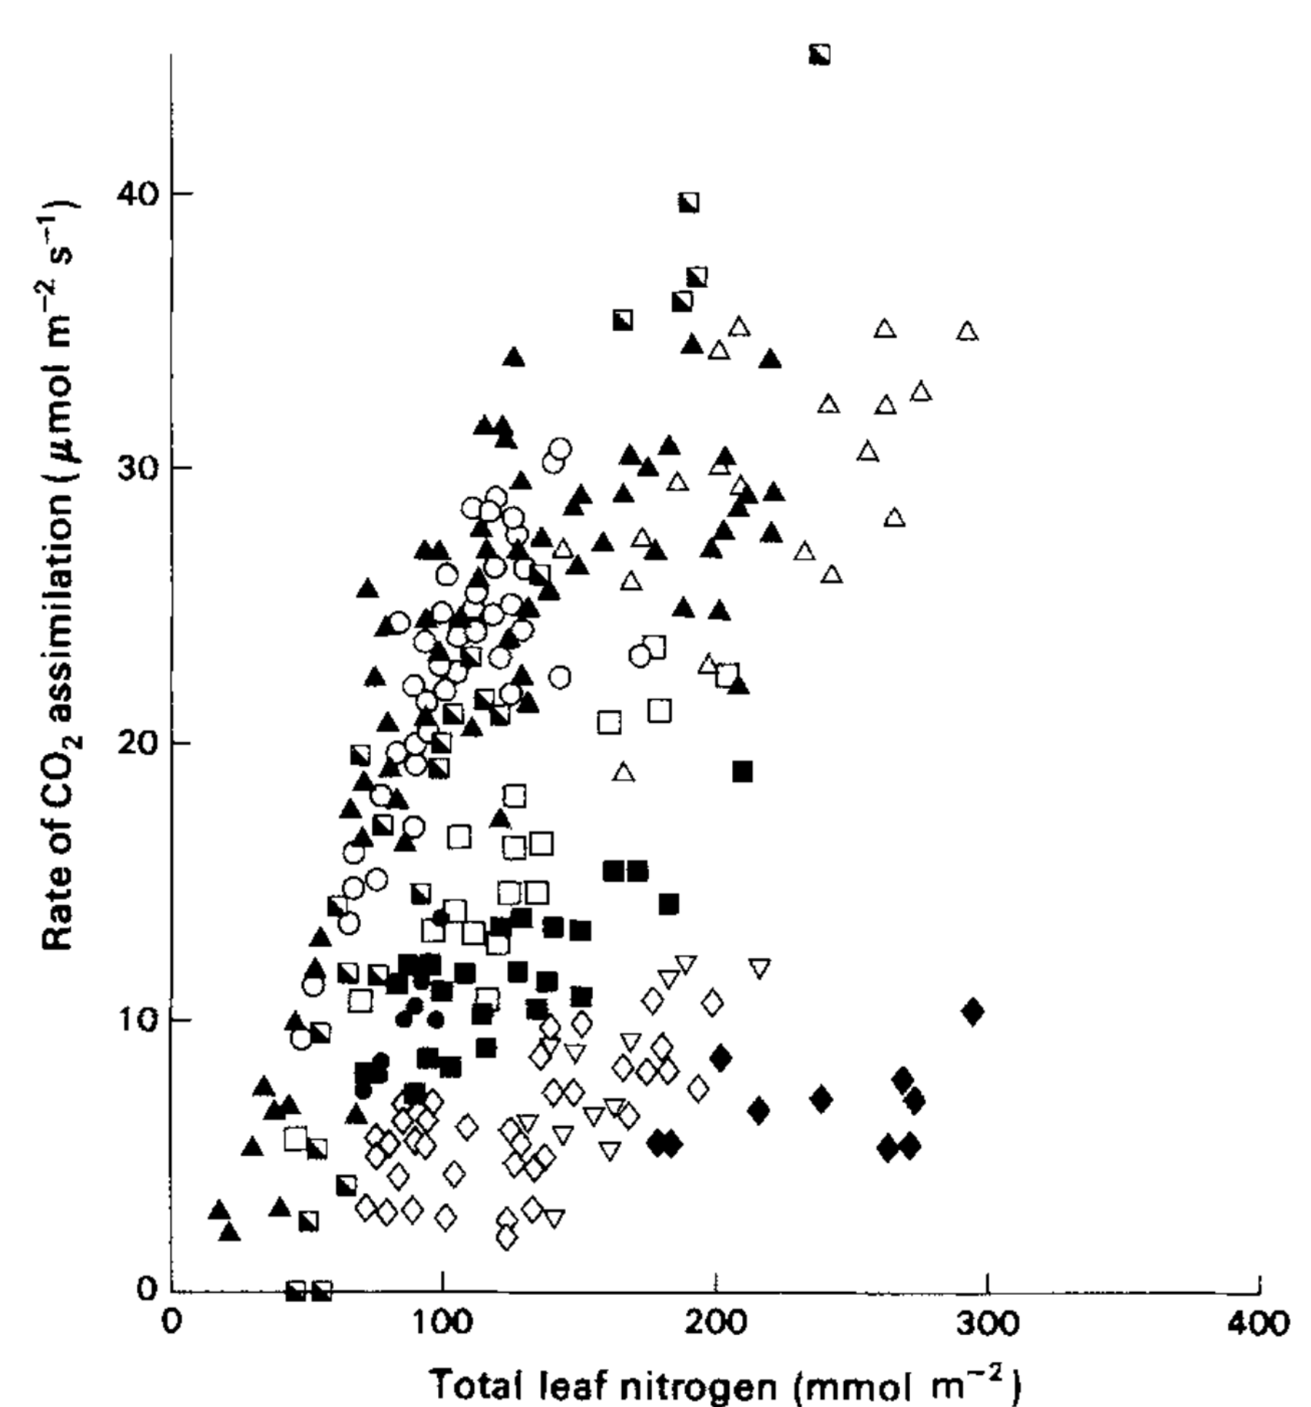
Terrestrial biosphere models simulate photosynthesis through linear relationships between leaf nitrogen content and photosynthetic capacity…
Evans (1989) Oecologia

Slide 7
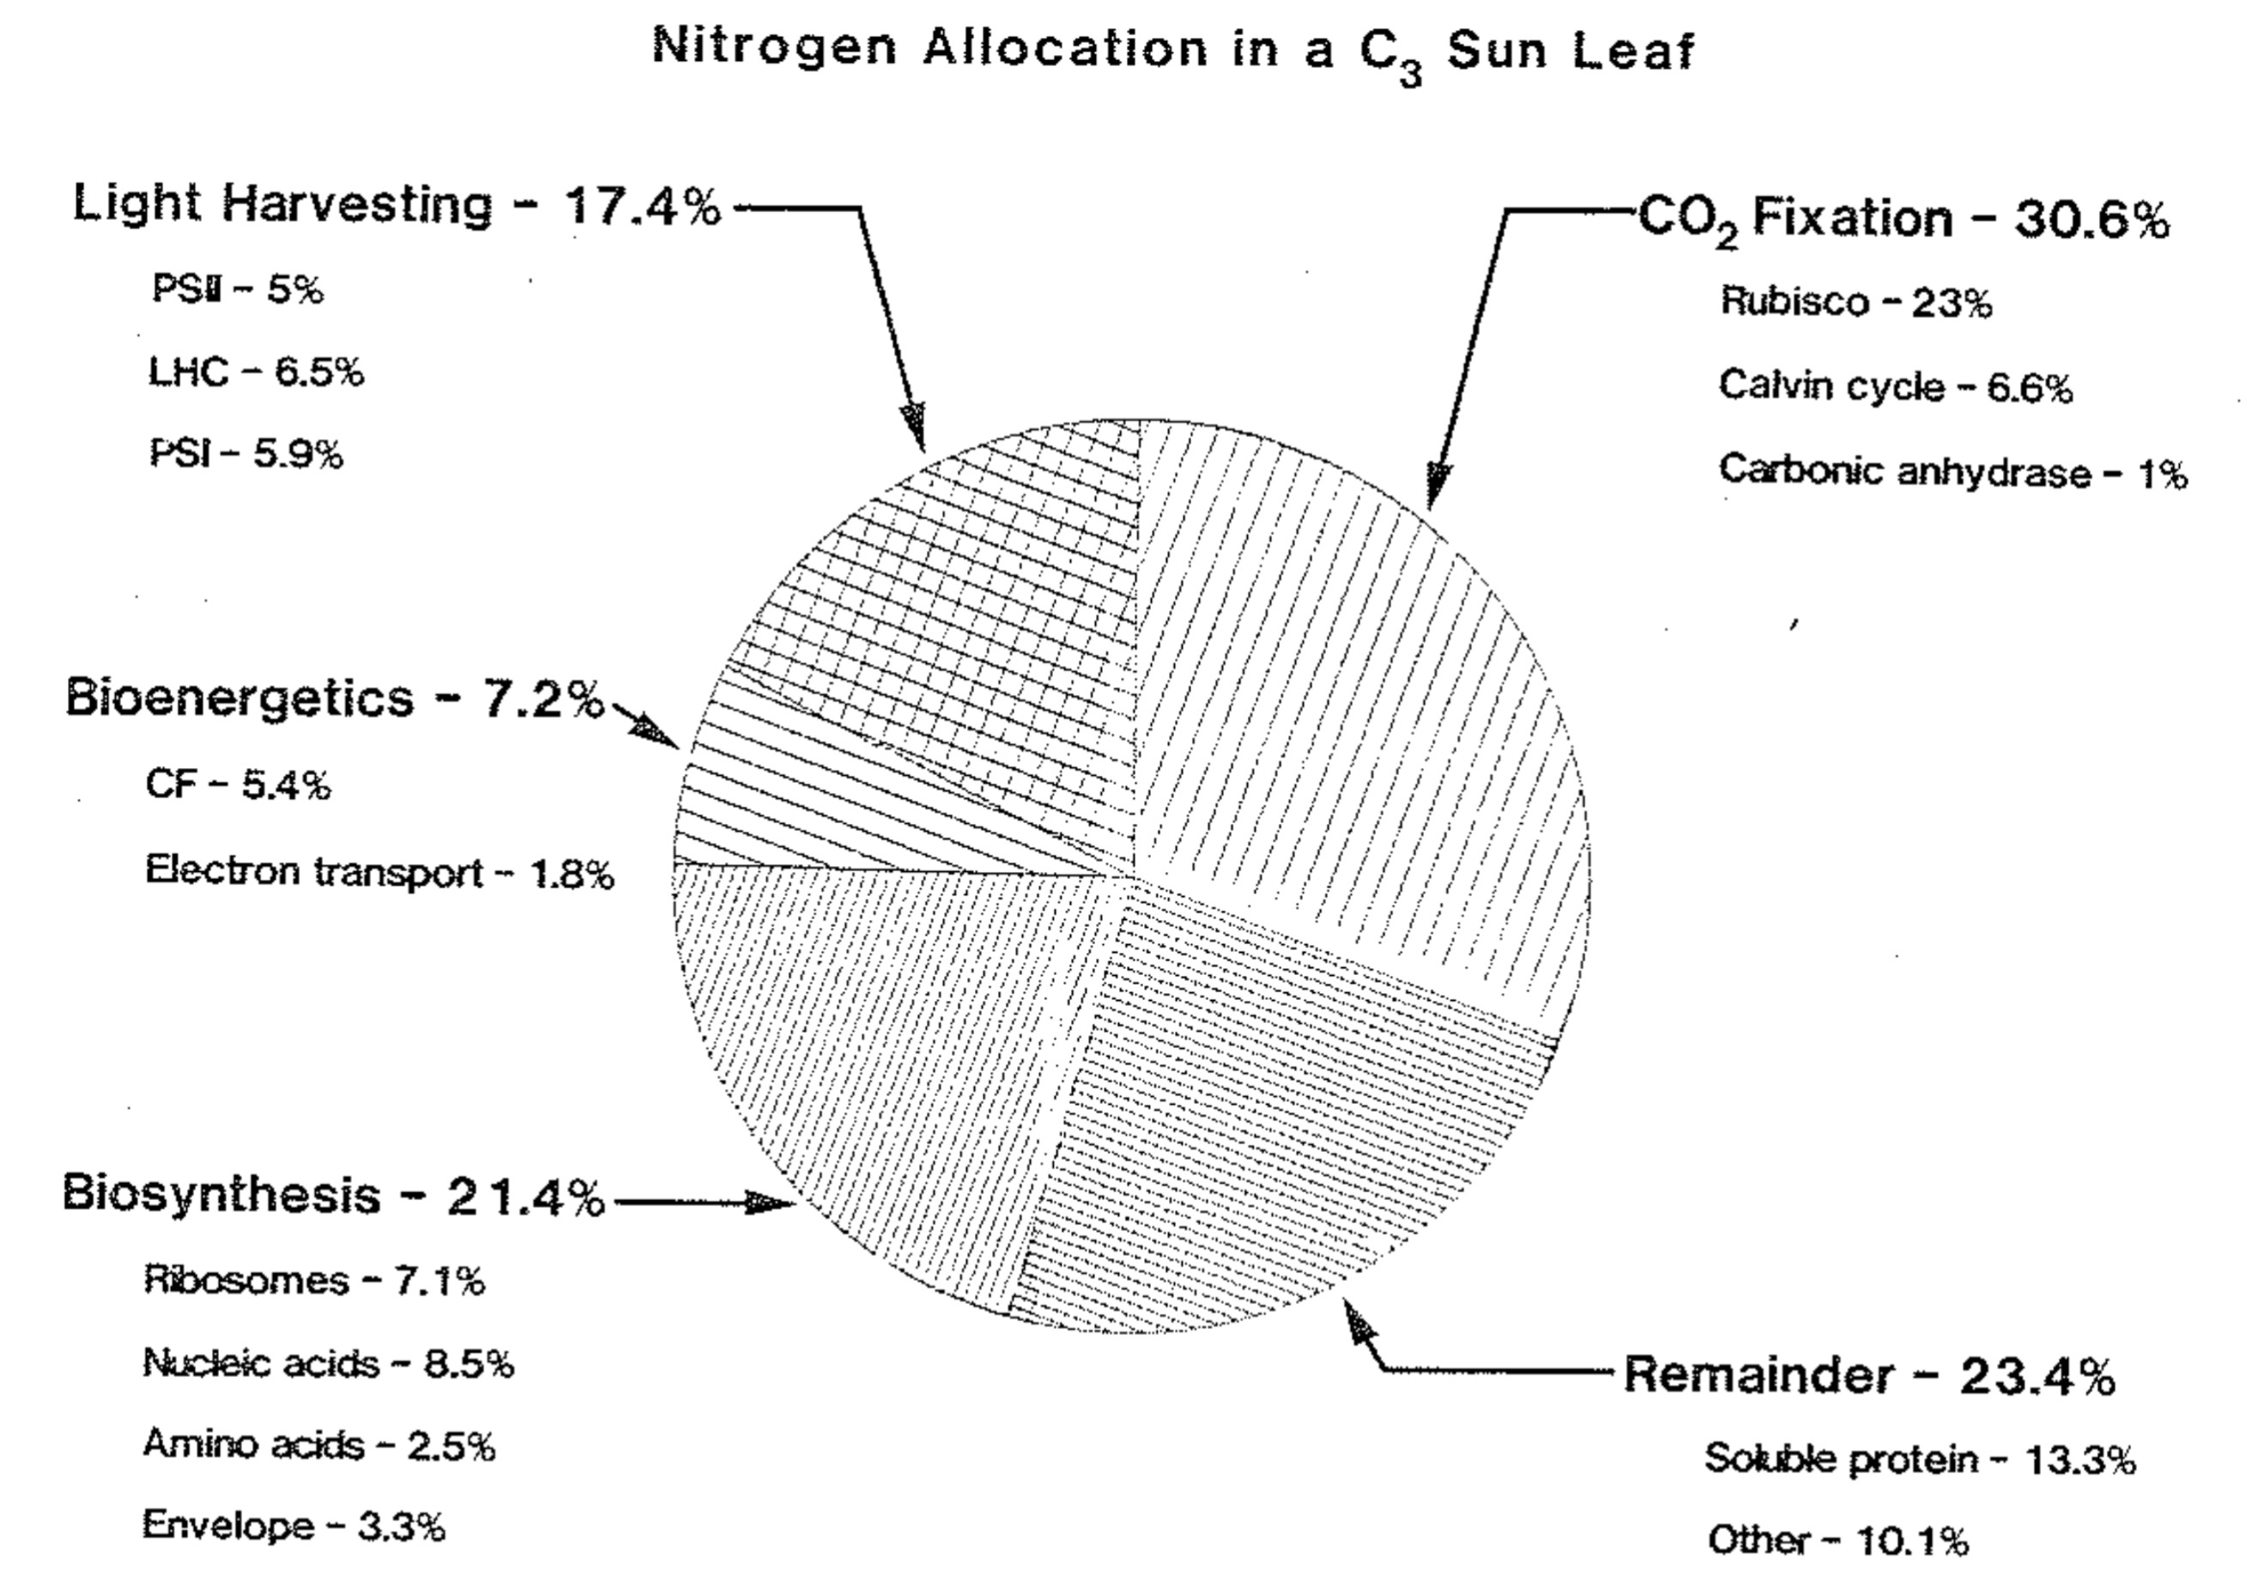
… following that high fractions of leaf nitrogen content are allocated to photosynthetic tissues
Evans (1989) Oecologia
Evans & Seemann (1989) Photosynthesis

Slide 8
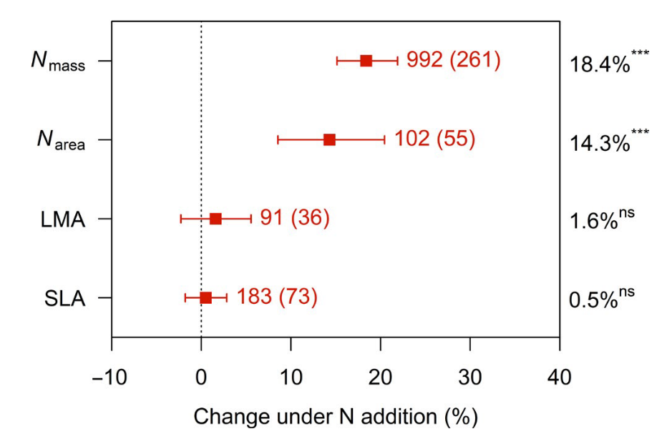
Soil nitrogen generally increases leaf nitrogen…
Liang et al. (2020) Global Change Biology

Slide 9
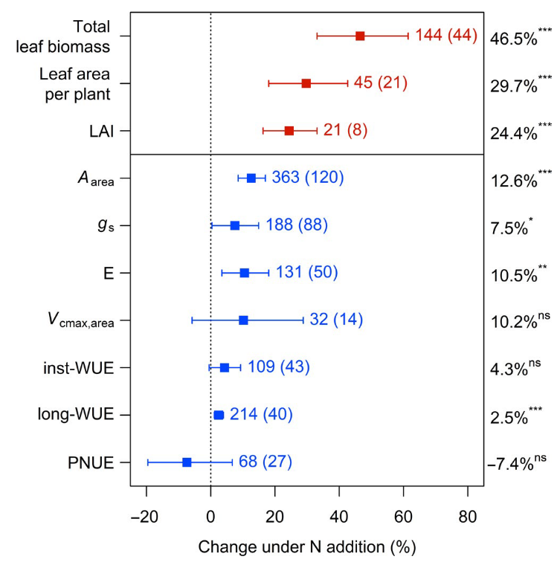
… which corresponds with increased photosynthesis
Liang et al. (2020) Global Change Biology

Slide 10
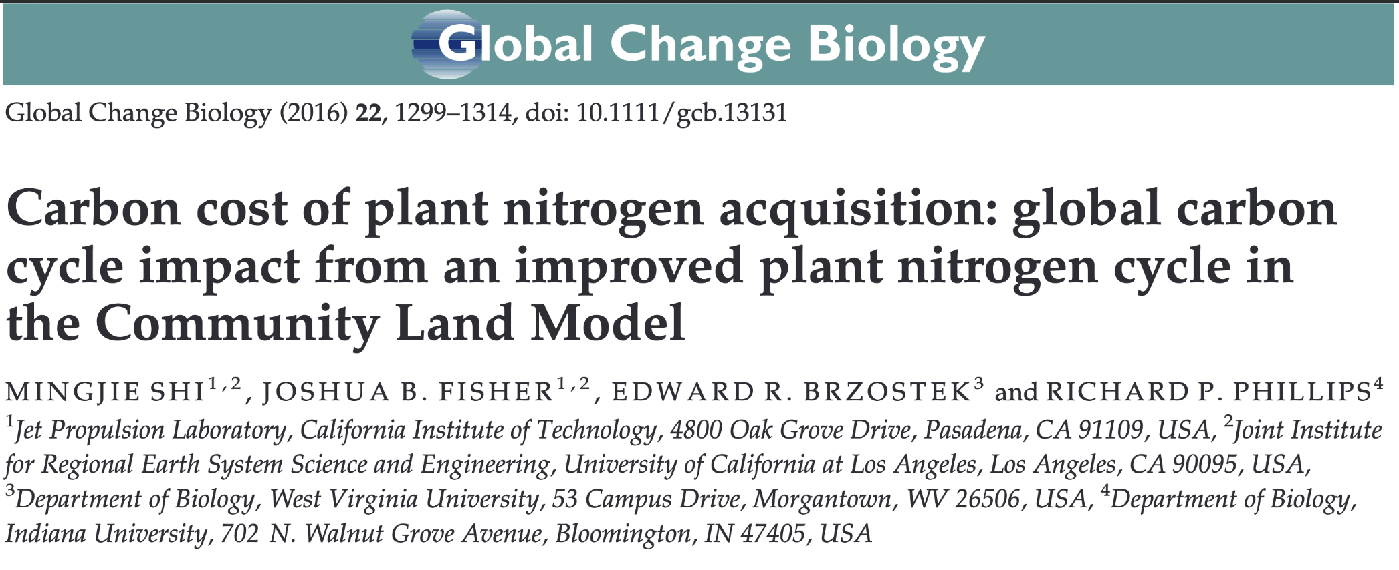
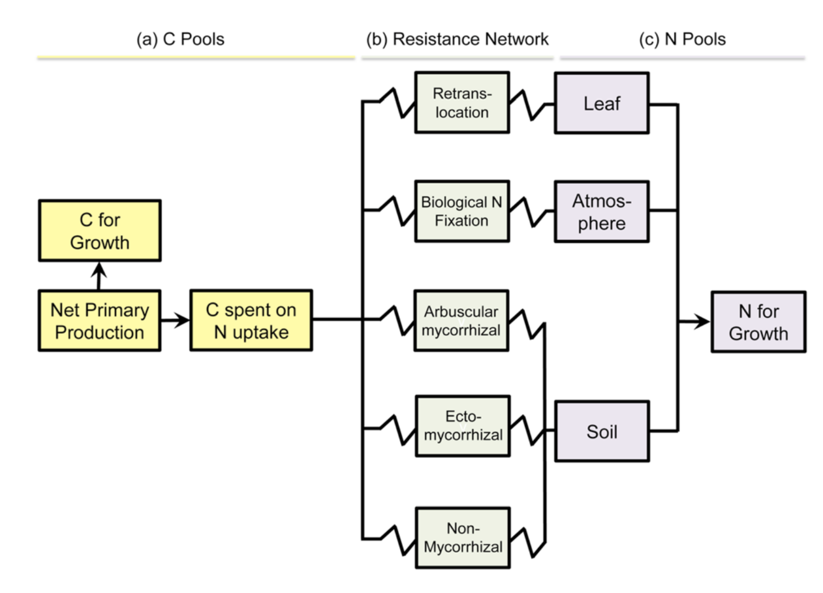
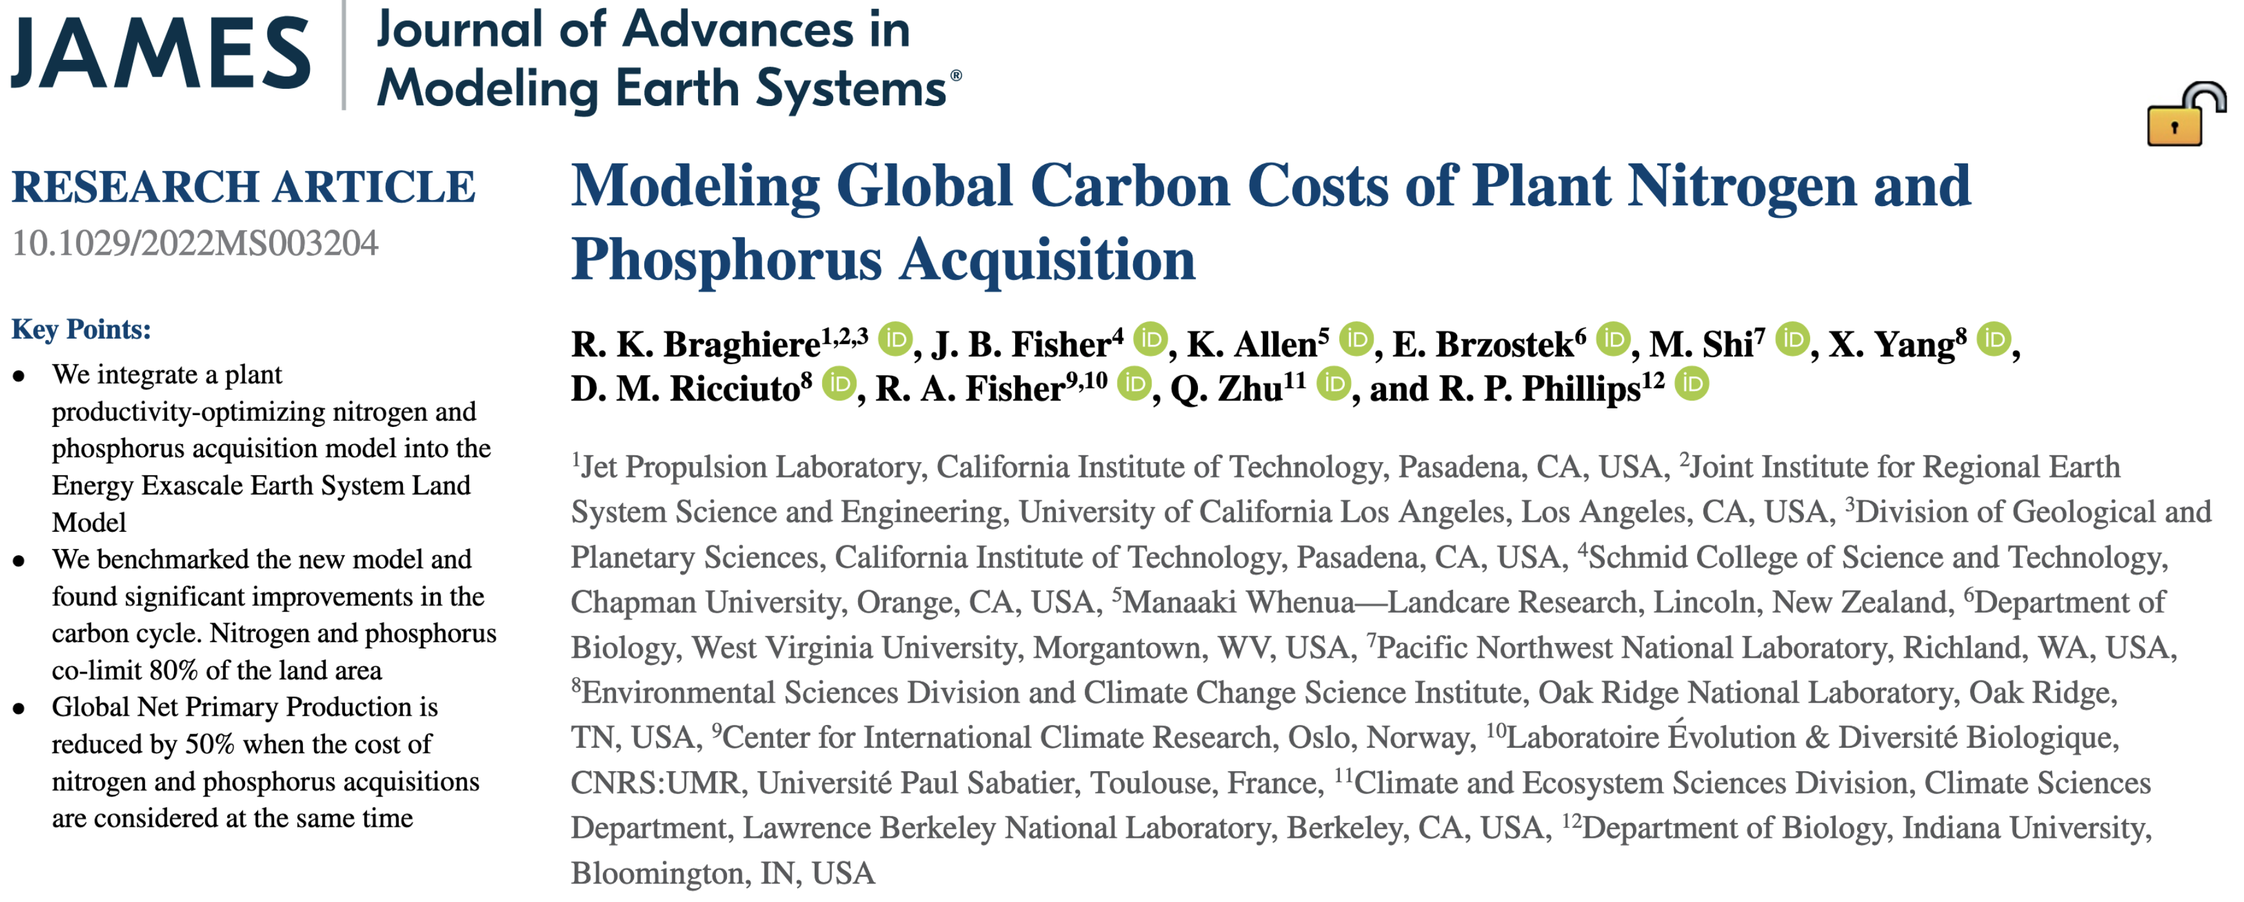
Models are beginning to incorporate coupled carbon and nitrogen cycles...
Brzostek et al. (2014)

Slide 11
Which means that leaf photosynthesis is indirectly predicted through changes in soil nitrogen availability
Soil N
Leaf N
Photo-synthesis
Braghiere et al. (2022) JAMES

Slide 12
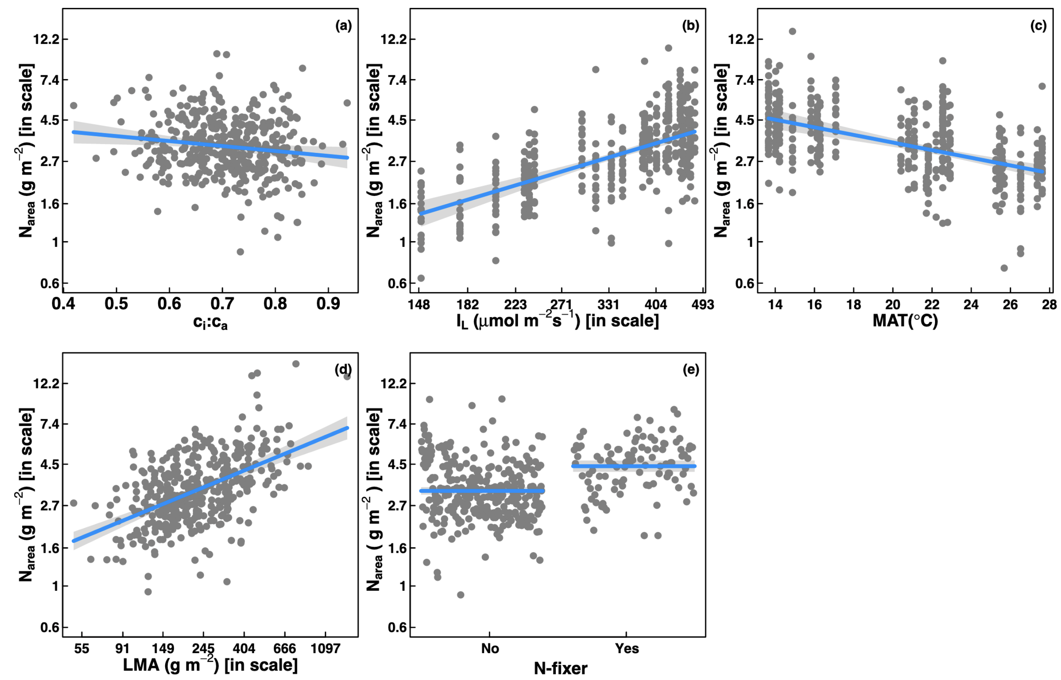
However, leaf nitrogen can be also predicted independent of soil nitrogen
Dong et al. (2017) Biogeosciences
Notes:
calls the use of these relationships in terrestrial biosphere models into question

Slide 13
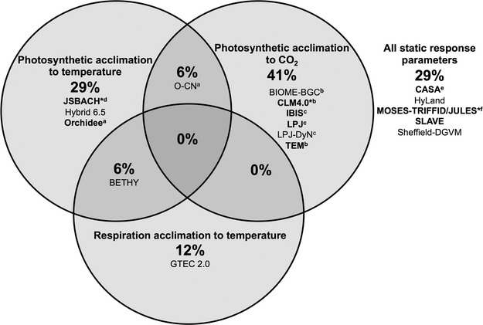
Terrestrial biosphere models also do not invoke plant acclimation responses to changing environments
Smith & Dukes (2013) Global Change Biology

Slide 14
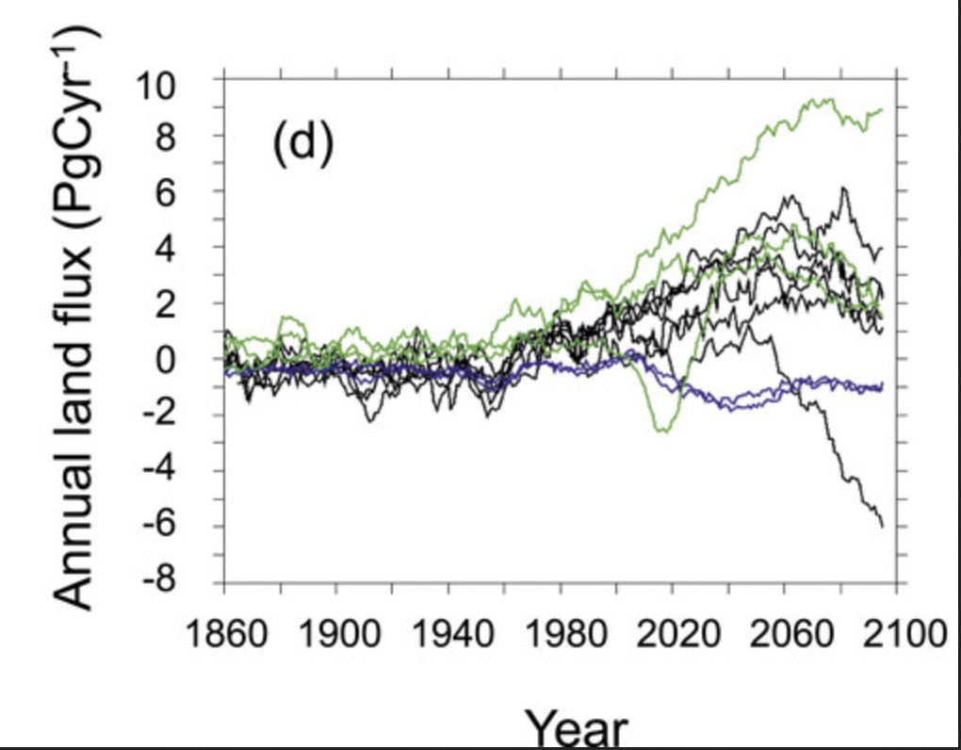
Large divergence in model simulations under future experiments
Perhaps as a result of
uncertainty in the response of
photosynthetic processes to
future environmental conditions?
Friedlingstein et al. (2014) Journal of Climate

Slide 15
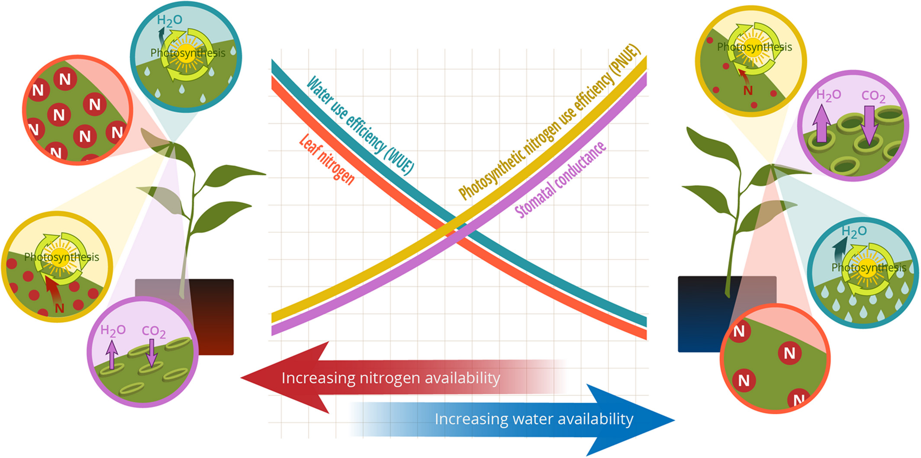
Photosynthetic ‘least-cost’ theory: leaves acclimate to changing climatic and edaphic environments via summed cost of resource use (nitrogen and water)
Bialic-Murphy et al. (2021) Ecology Letters

Slide 16
Photosynthetic ‘least-cost’ theory: leaves acclimate to changing climatic and edaphic environments via summed cost of resource use (nitrogen and water)
Bialic-Murphy et al. (2021) Ecology Letters

Slide 17
While promising, empirical tests of the theory are sparse

Slide 18
Primary Vignettes of Dissertation
Vignette 1: How do costs of nitrogen acquisition vary across environments?
Vignette 2: To what extent do edaphic and climatic factors modify nitrogen-water use tradeoffs?
Vignette 3: How does soil nitrogen availability modify plant acclimation responses to elevated CO₂?

Slide 19
Experiments

Slide 20
Experiment 1

Slide 21
Experiment 1
Vignette 1
Light availability treatments
Soil fertilization treatments
Species
0% shade cover
0 ppm N
30% shade cover
70 ppm N
Gossypium hirsutum
50% shade cover
210 ppm N
Glycine max
80% shade cover
630 ppm N

Slide 22
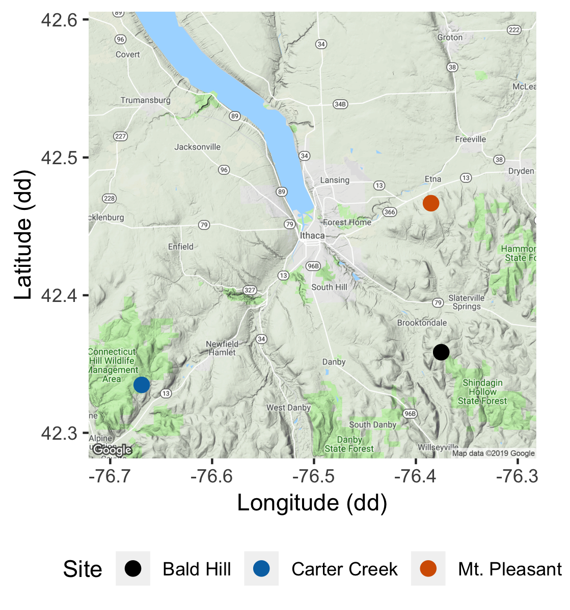
Experiment 2
Vignette 2
Soil fertilization treatments
Sites
0 kg ha⁻¹ yr⁻¹ N; 0 kg ha⁻¹ yr⁻¹ S
Bald Hill
0 kg ha⁻¹ yr⁻¹ N;
57 kg ha⁻¹ yr⁻¹ S
Mount Pleasant
50 kg ha⁻¹ yr⁻¹ N;
0 kg ha⁻¹ yr⁻¹ S
Carter Creek
50 kg ha⁻¹ yr⁻¹ N; 57 kg ha⁻¹ yr⁻¹ S

Slide 23
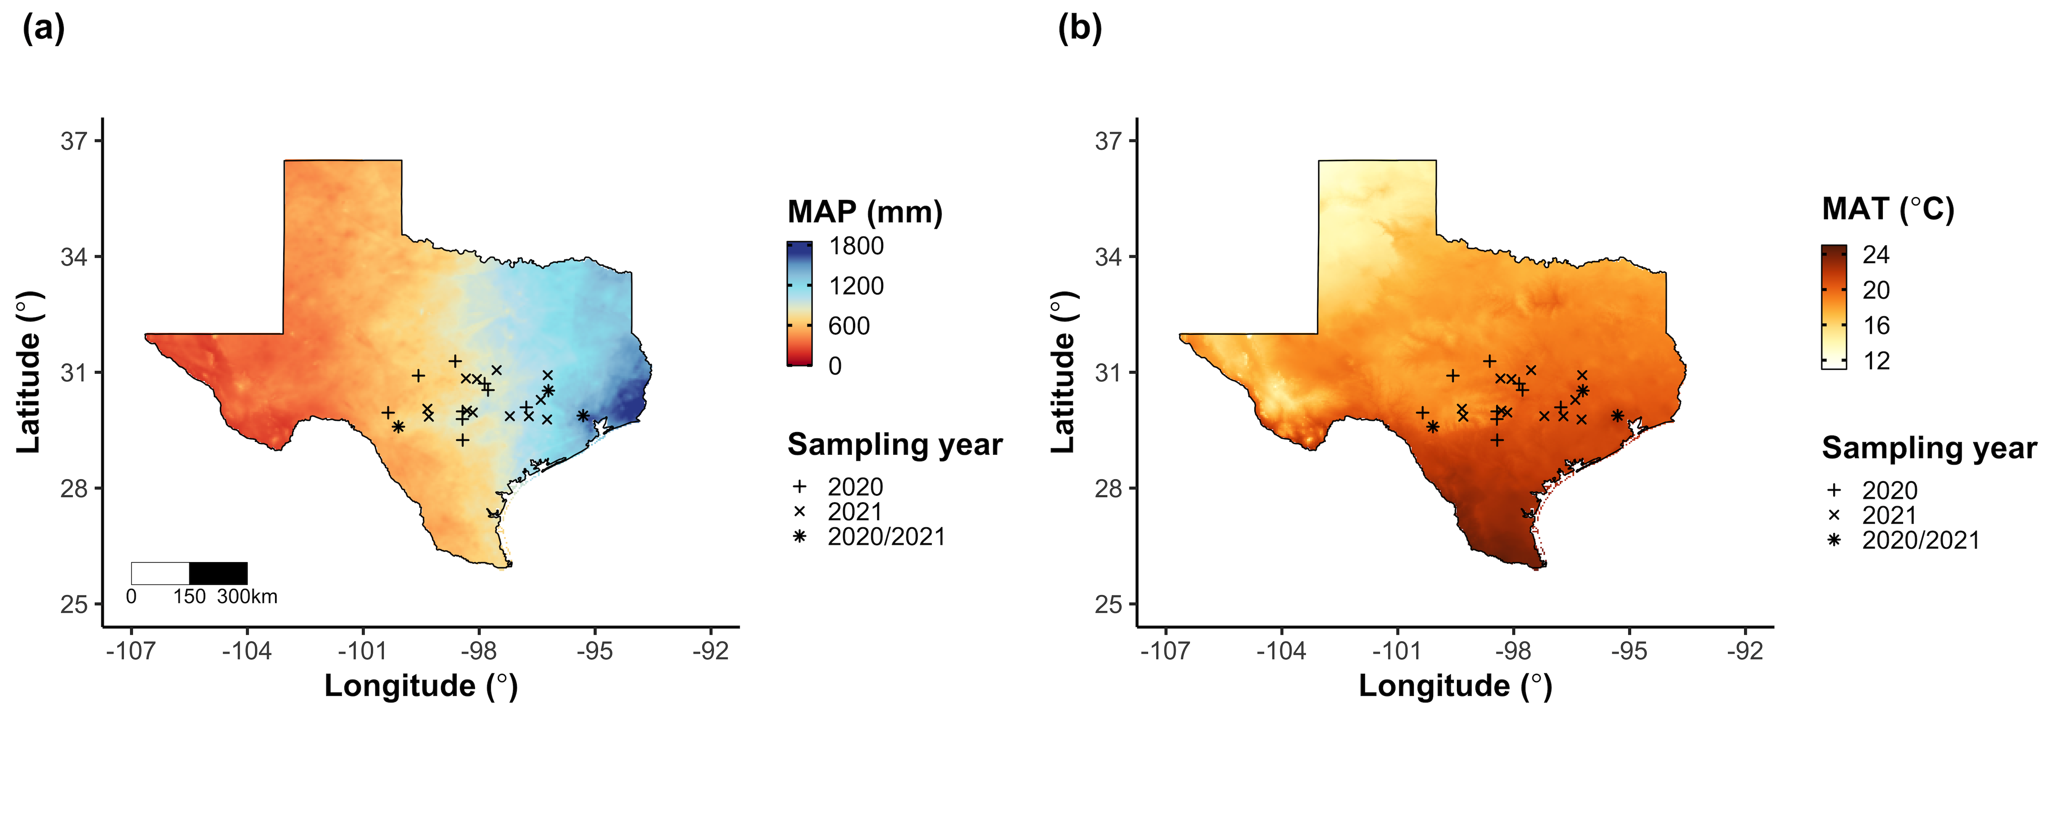
Experiment 3
Vignette 1
Vignette 2
24 sites
12 in 2020
15 in 2021 (3 same from 2020)
3 leaves of 5 most dominant species at each site
Leaf nitrogen content
Leaf C_{i}:C_{a} (δ¹³C)
Cost of acquiring nitrogen relative to water (β)
Composite soil sample
[NO₃-N]

Slide 24
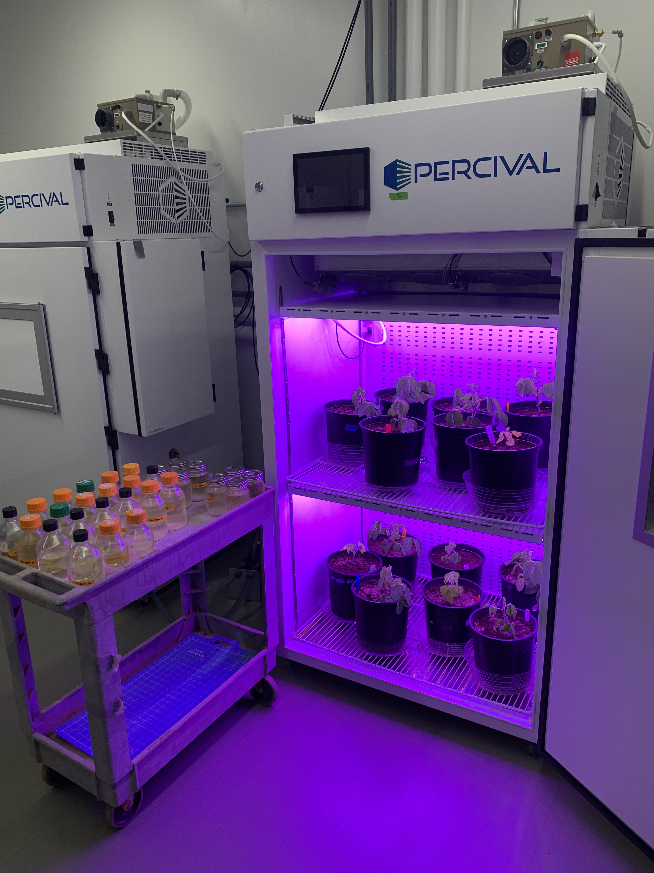
Experiment 4
Vignette 1
Vignette 2
Vignette 3
Acquisition strategy
Soil N treatments
0 ppm N
+ BNF
35 ppm N
- BNF
70 ppm N
105 ppm N
CO₂ treatments
140 ppm N
210 ppm N
+ BNF
280 ppm N
- BNF
350 ppm N
630 ppm N

Slide 25
Vignette 1: How do costs of nitrogen acquisition vary across environments?

Slide 26
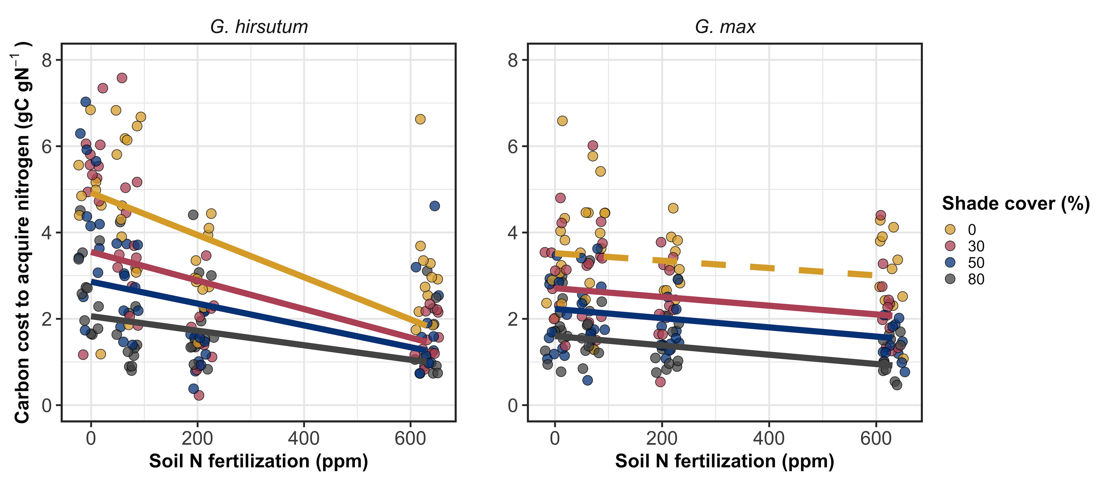
Structural costs of nitrogen acquisition decrease with increasing soil nitrogen availability
Perkowski et al. (2021) Journal of Experimental Botany

Slide 27
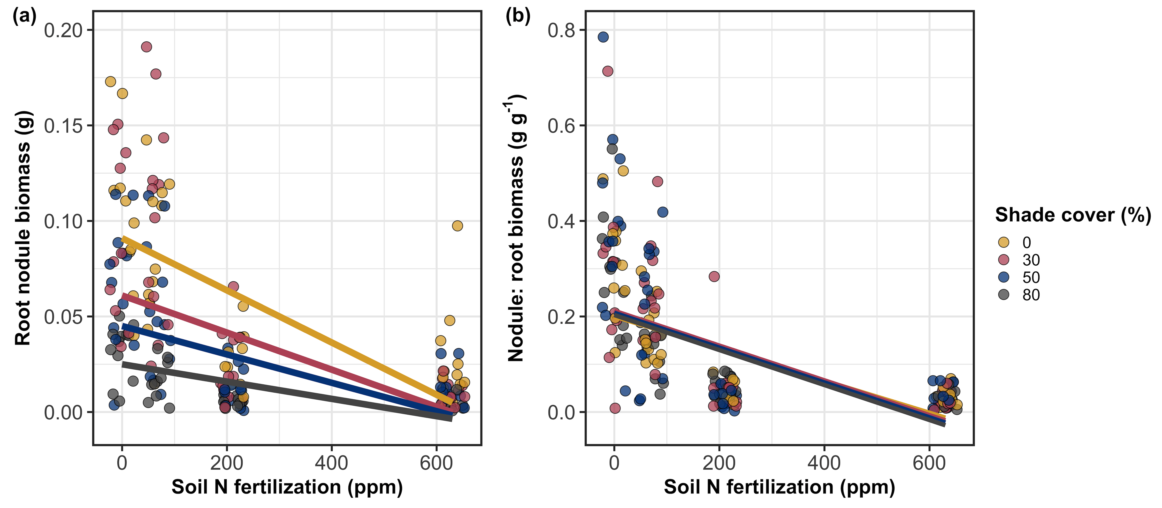
Reduced response of G. max to soil nitrogen may be due to reduced investment in root nodules
Perkowski et al. (2021)

Slide 28
Vignette 2: Tradeoffs between nitrogen and water use are apparent across environments

Slide 29
Vignette 3: Leaf acclimation responses to elevated CO₂ are independent of soil nitrogen availability

